Slide 1
Music Genre Classification
Name | ID
M. J. Darad | 162 0520 042
CSE465.2

Slide 2
Background
Extract meaningful information from songs
Application
Copyright monitoring
Identify song mood/emotions
Music recommendation system
Playlist generation
Optimize song search
Current approaches rely on user input
Unscalable, tedious, highly subjective
More than 75k albums released every year in the US
So, automatic techniques for genre classification are required

Slide 3
Literature Review
Tzanetakis and Cook (2002) addressed this problem with Supervised Machine Learning approaches
Gaussian Mixture Model classifiers
k-nearest neighbour (KNNs) classifiers
Scaringella and Zoia (2005); Soltau et al. (1998) uses Hidden Markov Models (HMMs)
Mandel and Ellis (2005) addressed this problem with Support Vector Machines (SVMs)

Slide 4
Training Set
Song Dataset
Feature Extraction
Testing Set
Accuracy
Classifiers
Neural Net

Slide 5
Dataset
GTZAN Dataset
1000 audio files
In .au format
16 bit
22050 Hz
30 sec each
Category
Blues
Classical
Country
Disco
Hip-hop
Jazz
Metal
Pop
Reggae
Rock

Slide 6
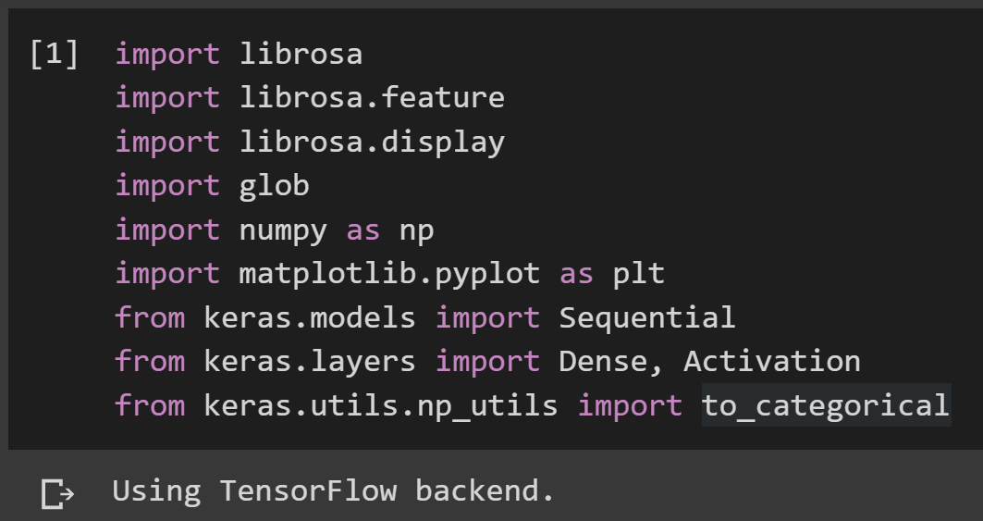
Librairies

Slide 7
Feature Extraction
Mel Cepstrum Frequency Coefficients (MFCC)
MFCC values mimic human hearing,
Widely used feature for speech/sound recognition applications as well as music classification
Takes into consideration human perception of frequencies
Some frequencies are more ‘important’ to human ear than others
MFCC values will be fed directly into the neural network

Slide 8
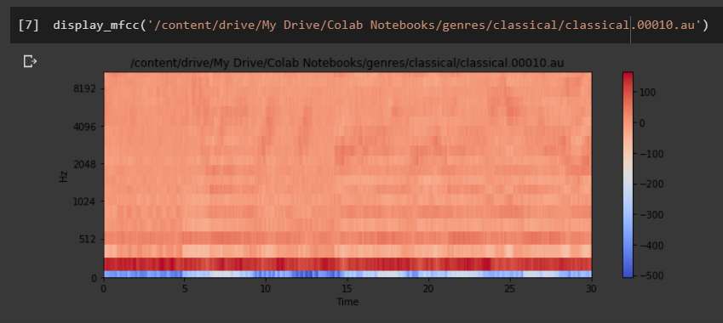
Visualization

Slide 9
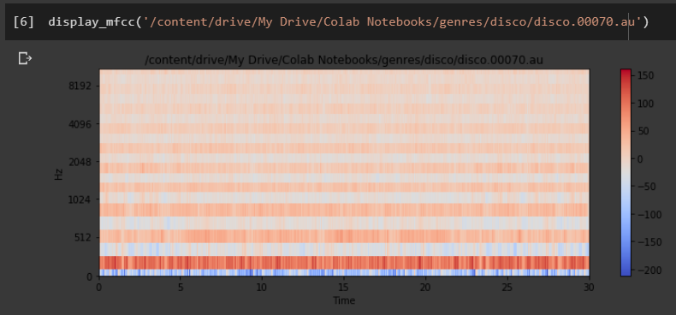
Visualization

Slide 10
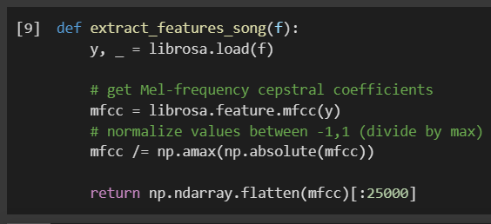
Qualifying song genres
use librosa to get MFCC value
these values may be between negative 250 to positive 150
they are not good for a neural network
need to feed in values near negative 1 and positive 1 or from 0 to 1

Slide 11
Qualifying songs to get MFCC values and class names
a function called generate _features_and_labels(),
go through all the different genres
go through all the songs in the dataset
produce the MFCC values and the class names
there are 100 songs each for each file (10 genre)
put those features in the all_features.append(features) list
name of the genre for that song needs to be put in a list as well
all features will have 1,000 entries
all labels will have 1,000 entries
In the case of all features, each of those 1,000 entries will have 25,000 entries
So its a 1,000 x 25,000 matrix

Slide 12
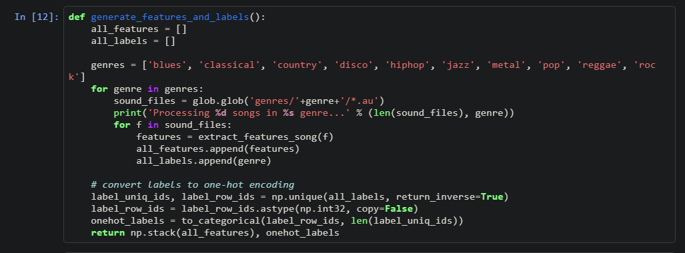
Qualifying songs to get MFCC values and class names (cont.)

Slide 13
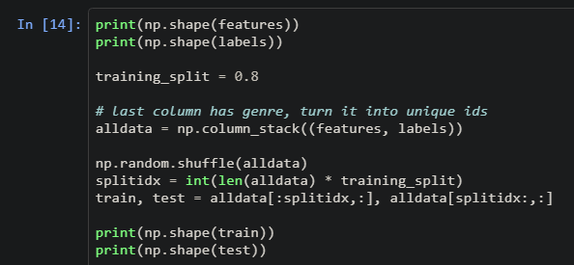
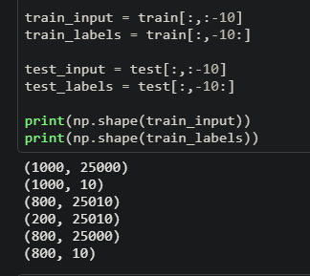
print the shape of the features and the labels
it is 1,000 x 25,000 for the features and 1,000 x 10 for the labels
split the dataset into a train and test split
Decide the 80% mark defined as training_split= 0.8 to perform a split

Slide 14
Neural Network

Slide 15
Neural Network
Used a sequential neural network
The first layer is a dense layer of 100 neurons
25,000 values are going to connect to the 100 in the first layer
The first layer will do the weighted sum of its inputs, its weights, and bias term
then run the ReLU activation function
relu states that anything less than 0 will turn out to be a 0
anything higher than 0 will just be the value itself
These 100 will then connect to 10 more and that will be the output layer
It is10 because we have done one-hot encoding and have 10 binary numbers in that encoding
The activation function used is softmax
take the output of the 10 and normalize them so that they add up to 1.
That way, they end up being probabilities
Now consider the highest scoring or the highest probability out of the 10 as the prediction

Slide 16
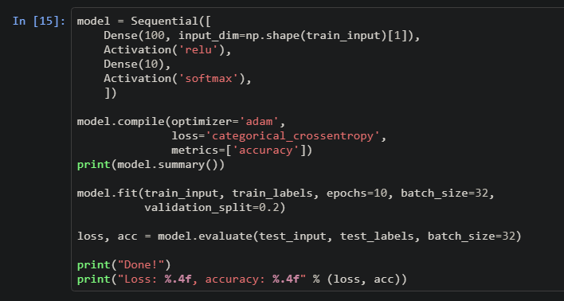
Neural Network

Slide 17
Work Done
Found the GTZAN dataset
Pre-process data using MFCC
Data analysis by plotting graphs
Splitting the dataset into
Training dataset
Testing dataset
Used valina neural network
Training the model

Slide 18
Future Work
Tune the model to to improve the performance
To find best number of hidden layers
suitable number of nodes
Use other types of neural networks
convolutional neural network (CNN)
Evaluation of the Trained Model with the Test Dataset
Use Confusion Matrix
Check Accuracy
Find the best model

Slide 19
Thank you!!

